Slide 1





"MAJOR PROJECT"
ADVANCED PROGNOSTIC FRAMEWORK FOR
Multi-Disease Prediction Utilizing
Machine Learning Algorithms
SYSTEM THAT IS CAPABLE OF DETECTION OF MULTIPLE DISEASES ON SINGLE PLATFORM
Developed By-
Utkarsh Jain- 2100290100178
Pranav Mishra- 2100290100116
Tushar Kumar- 2100290100176
Guide Name-
Mr. Rahul Kumar Sharma
PROJECT ID- PCSE25-68
TEAM NAME- CURECRAFTERS

Slide 2



CONTENT OF PRESENTATION
This presentation contains
1
Problem Statement and Motivation to develop our Project
2
Objective Behind our Project
3
Methodology to develop our Project
4
Technologies used to develop our Project
5
Timeline of completion of our Project
6
Ongoing Work related to our Project
7
Future Aim of our Project

Slide 3


PROBLEM SATEMENT
1)The existing model can only forecast one or two illnesses, which may include diseases such as heart disease, lung disease, or brain disease.
2)The most widely used models even have accuracy and timely response-related issues.
3)Some patients are also confronted with the problem of medical terminology being questioned in the detection system.

Slide 4

OBJECTIVE
1)The goal of this significant project is to build a thorough platform that has the capability to detect multiple illnesses like Diabetes, Brain Disease and Heart Disease prediction system.
2)The main motive is to increase the speed and accuracy of illness detection of pre-existing models.
3) The model will be able to provide medical workers with relevant tools to help them make decisions, allowing for early detection and intervention, minimizing the rate of misdiagnosis, and improving patient outcomes.
4) This model also aims to provide an pre diagnosis to an patient with no medical background so to receive the dedicated treatment of the disease.

Slide 5

METHODOLOGY
1) A survey will be conducted on terminally ill patients and information in the form of text and symptoms were collected from them.
2) According to the collected data we will develop the model according to it and train the model accordingly.
3)The method to calculate the disease percentage we will use particular formulas which are based on linear regression if data is entered other than our collected data.
4)Then we will develop the front end for the deployment of our model and test the system capabilities.
5) We will then deploy our Machine Learning Model on the Page we have created.

Slide 6
TECHNOLOGIES USED
1) Machine learning approaches that will use the Streamlit module for the deployment of our model on our front end.
2) Flask module will be used to develop our front end for our model.
3) Data storage is used depending on the requirements, structured or unstructured databases can be used to store disease, simulation results, or trained models.
3) For model development of our model we will use a Deep Learning Technology that is Natural Language Processing (NLP) for text understanding.
4) Logistic regression (LR) is one of the most widely used multivariate linear models for medical data analysis.

Slide 7
MODEL FORMATION
For Model for Diabetes Prediction:
1) We have started forming code in the Google Collaboratory.
2) We have shortlisted the method to collaboratary the models by using Pickle Files in Sypder IDE available in Anaconda.
3) The model will be hosted using Streamlit Library which will be writted in the code of the Spyder Code.
4) Pickle Library will be used even for the stream lining the switch between the model.

Slide 8

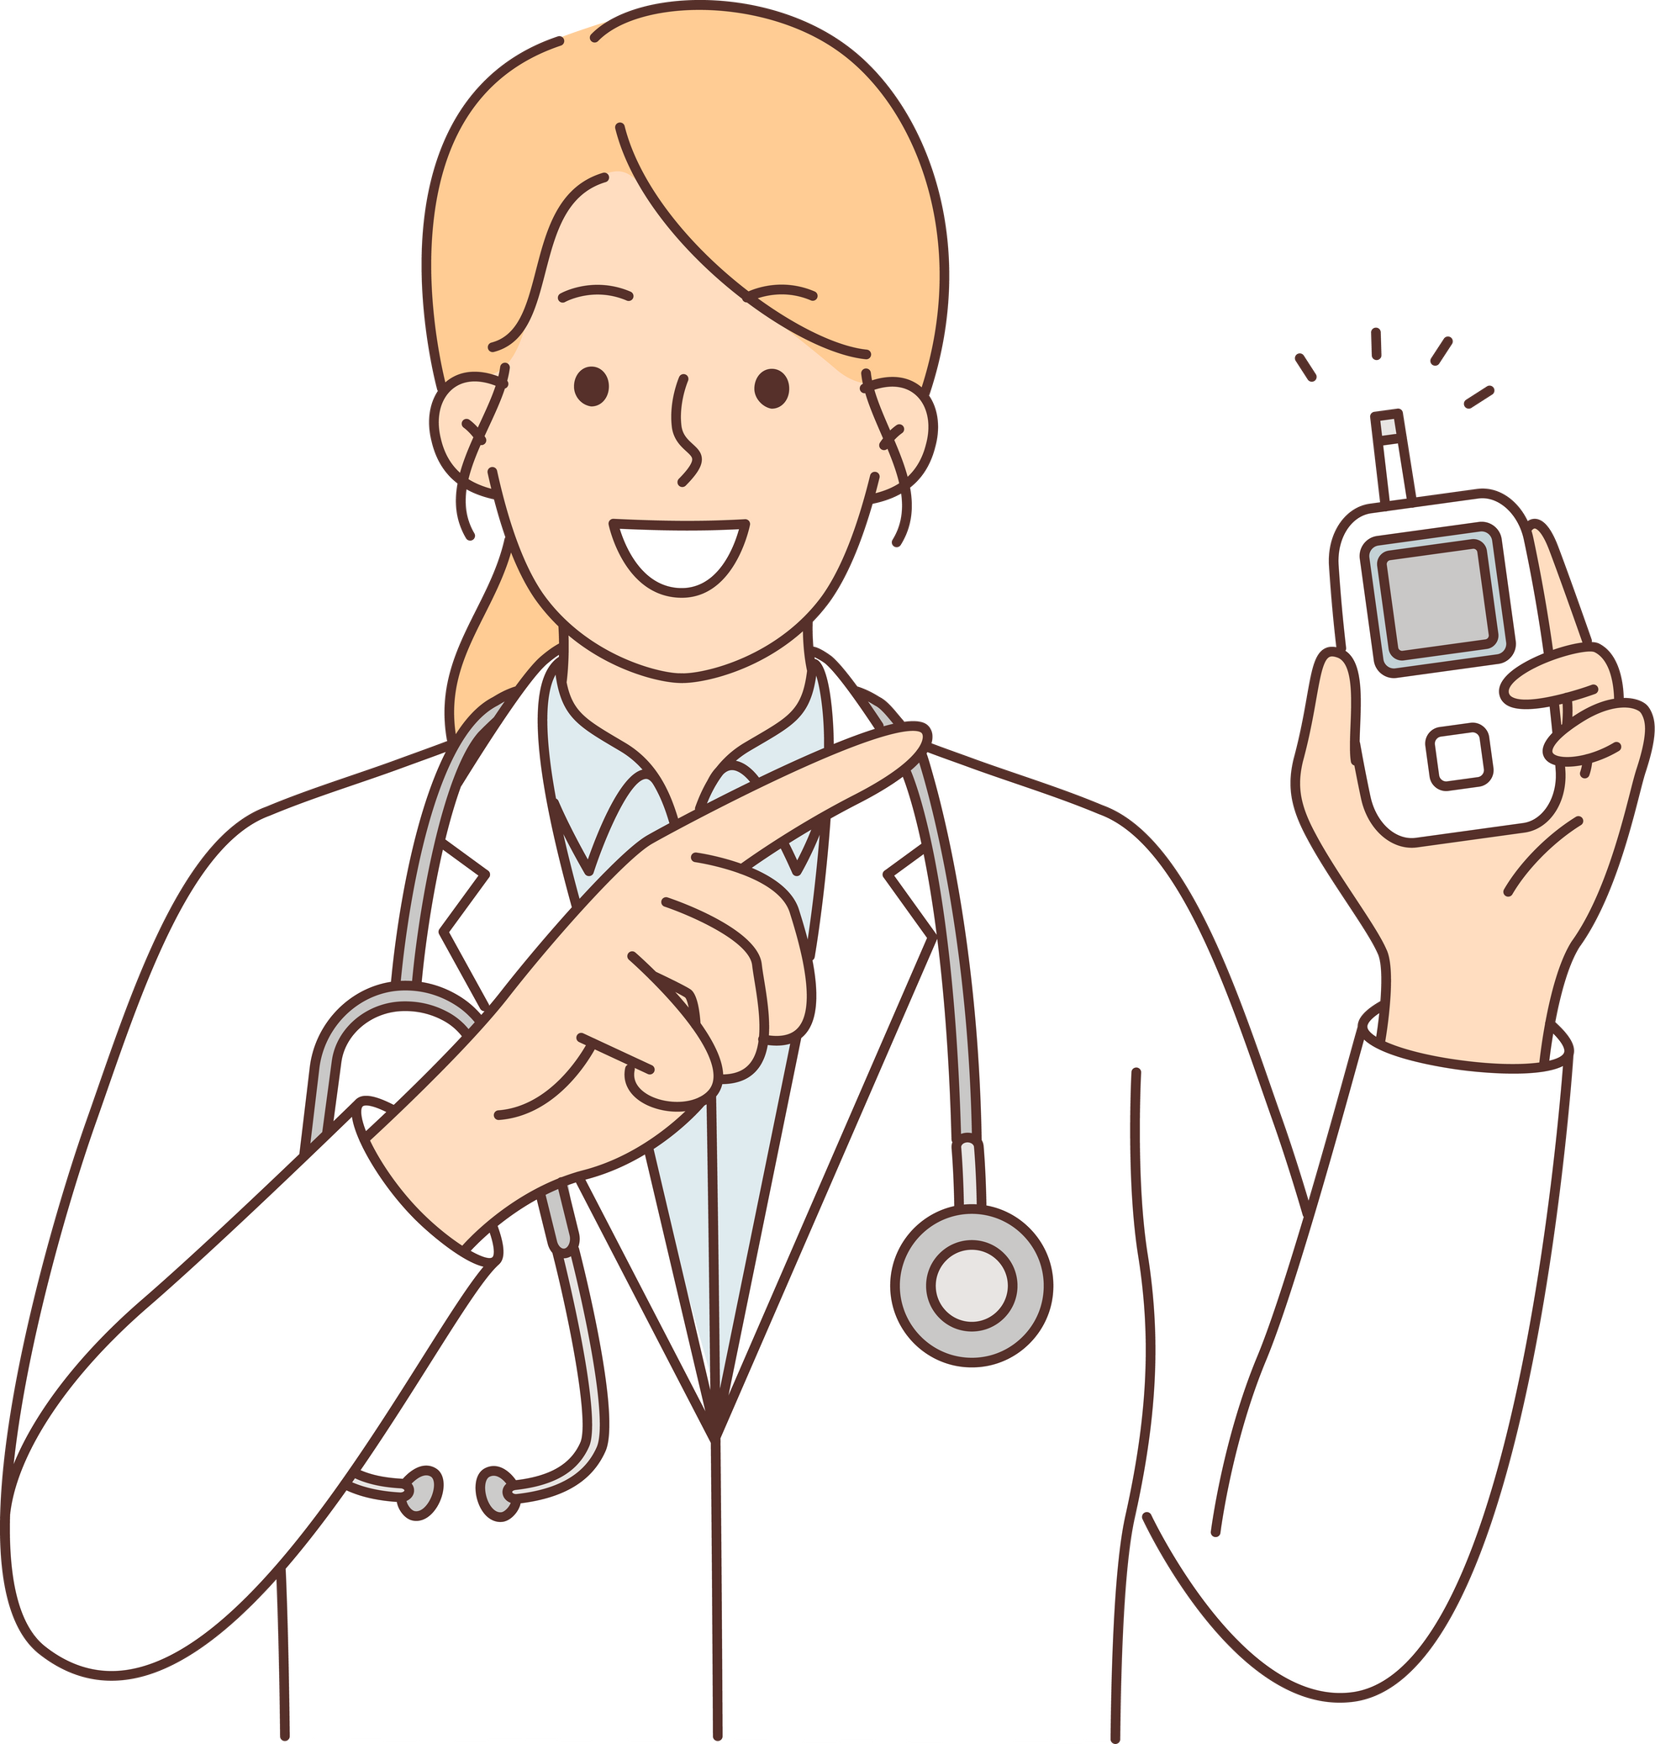
DATA COLLECTED
For Diabetes Analysis:
Parameters are:
Blood Pressure, Skin Thickness, Insulin, BMI, Diabetes Pedigree Function, Age, etc.
Implementation:
The final model’s behaviour will be saved as a Python pickle file. Flask API is designed. When a user accesses this API, the user has to send the parameters of the disease along with the disease name. Flask API will invoke the corresponding model and return the status of the patient. The importance of this analysis to analyse the maximum diseases, so that to monitor the patient's condition and warn the patients in advance to decrease mortality ratio.

Slide 9


DATA COLLECTED
For Heart Disease Analysis:
Parameters are:
Age, trestbps(reading of the resting blood pressure), cholesterol, FPS(fasting Glucose),thalach (person's maximum heart rate achieved), gender, previous history, coronary artery calcium (form of diastolic heart failure), etc.
Implementation:
Same as for the diabetes prediction model.

Slide 10
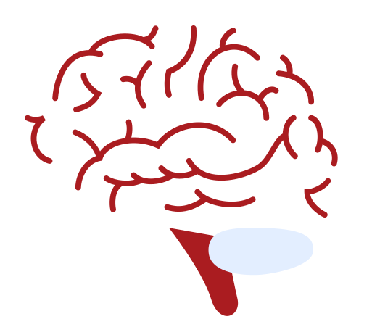
DATA COLLECTED
For Parkinson Analysis:
Parameters are:
Age,MDVP:Fo(Hz), MDVP:Fhi(Hz), MDVP:Flo(Hz), MDVP:Jitter(%), MDVP:Jitter(Abs), MDVP:RAP, MDVP:PPQJitter:DDP, MDVP:Shimmer, MDVP:Shimmer(dB), Shimmer:APQ3, Shimmer:APQ5, MDVP:APQ, Shimmer:DDA, NHRHNRstatus, RPDEDFAspread1, spread2D2PPE, etc.
Implementation:
Same as for the diabetes prediction model.

Slide 11
ONGOING WORK
A)These are the research paper which we are going through for the development, understanding and data collection from it: Martinez-Lopez, Joaquin, et al. . 'Prognostic value of deep sequencing method for minimal residual disease detection in multiple myeloma." Blood, The Journal of the American Society of Hematology" in 2014
B) For data collection, we are visiting many multi-speciality hospitals and local physicians.
C) Model development for diseases like Diabetes and heart disease is been implemented and has been completed.
D) Writing of research paper by initializing writing of abstract and introduction of the paper.

Slide 12





TIMELINE
Our project is expected to complete on the given timeline and will be fully functionable according to it.
Dec'23
Feb'24
June'24
July'24
Aug’24
Survey
and Data
Collection
Model Development
Model Development and Training
Frontend Development
Deployment

Slide 13

FUTURE AIMS
IMAGE PROCESSING
If our aimed targets are achieved that is our current work of the development and deployment of our model, then we aim to development of a model for diseases which are detected by photos.
So we will aim for photo processing for the detection of diseases like cancer and fungal diseases.
RESEARCH PAPER
After development of the project we aim to publish our work as our research.
We will achieve the aim by presenting our research paper in one of the conferences.

Slide 14


